Slide 1
More About Classes
CS 244

Slide 2
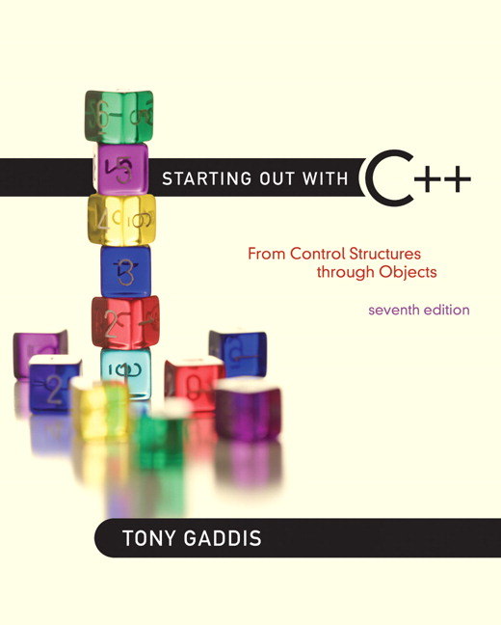

Chapter 14:
More About Classes

Slide 3
14.1
Instance and Static Members

Slide 4
Instance and Static Members
instance variable: a member variable in a class. Each object has its own copy.
static variable: one variable shared among all objects of a class
static member function: can be used to access static member variable; can be called before any objects are defined

Slide 5
static member variable
Contents of Tree.h
1 // Tree class
2 class Tree
3 {
4 private:
5 static int objectCount; // Static member variable.
6 public:
7 // Constructor
8 Tree()
9 { objectCount++; }
10
11 // Accessor function for objectCount
12 int getObjectCount() const
13 { return objectCount; }
14 };
15
16 // Definition of the static member variable, written
17 // outside the class.
18 int Tree::objectCount = 0;
Static member declared here.
Static member defined here.

Slide 6
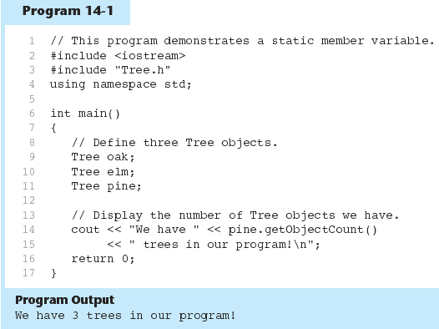

Slide 7
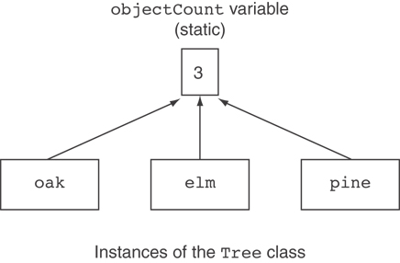
Three Instances of the Tree Class, But Only One objectCount Variable

Slide 8
static member function
Declared with static before return type:
  static int getObjectCount() const
  { return objectCount; }
Static member functions can only access static member data
Can be called independent of objects:
int num = Tree::getObjectCount();

Slide 9
Modified Version of Tree.h
1 // Tree class
2 class Tree
3 {
4 private:
5 static int objectCount; // Static member variable.
6 public:
7 // Constructor
8 Tree()
9 { objectCount++; }
10
11 // Accessor function for objectCount
12 static int getObjectCount() const
13 { return objectCount; }
14 };
15
16 // Definition of the static member variable, written
17 // outside the class.
18 int Tree::objectCount = 0;
Now we can call the function like this:
cout << "There are " << Tree::getObjectCount()
<< " objects.\n";

Slide 10
In-class Exercise 1
Modify your point class to count the number of points using a static member variable and function.
-have to add the static variable to the private section
e.g. static int pointcount;
-for each constructor, add a line:
pointcount++;
-After the class definition, add the static function
-Compile your class
-Write a main program to declare an arbitrary number of points and then print out the number.

Slide 11
14.3
Memberwise Assignment

Slide 12
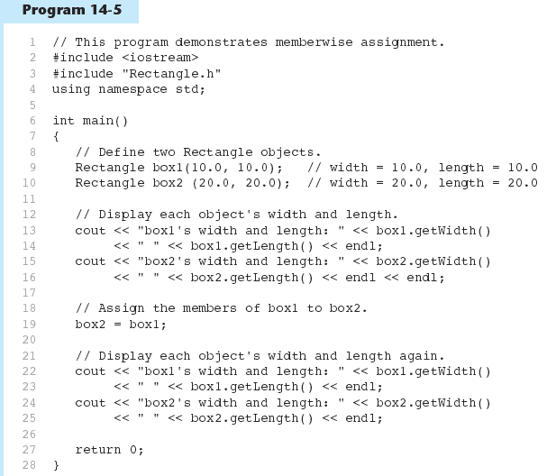

Slide 13
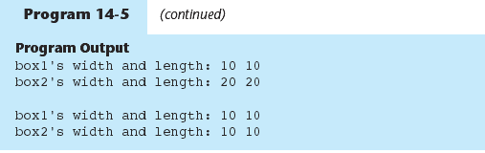

Slide 14
The this Pointer
this: predefined pointer available to a class’s member functions
Always points to the instance (object) of the class whose function is being called
Is passed as a hidden argument to all non-static member functions
Can be used to access members that may be hidden by parameters with same name

Slide 15
this Pointer Example
  class SomeClass
  {
  private:
  int num;
  public:
  void setNum(int num)
  { this->num = num; }
  ...
  };
  Note: one-line functions implemented in class definition.

Slide 16
In-class exercise #1
Modify the appropriate member functions in the Point class to use the this pointer.
  Function parameters will be the same as the private member variables
  References to the private member variables in the function will use: this

